Slide 1

Global Super Store
Exploratory Data Analysis Of The Global Superstore
Prajwal Jatti

Slide 2
Agenda
Store Overview In Sales
Order Summary
Sales Summary
Yearly Review

Slide 3




Store Overview In Sales

Slide 4
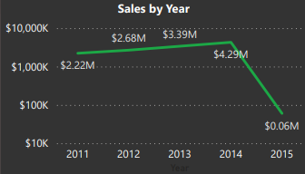
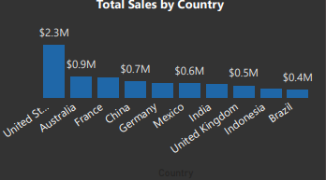
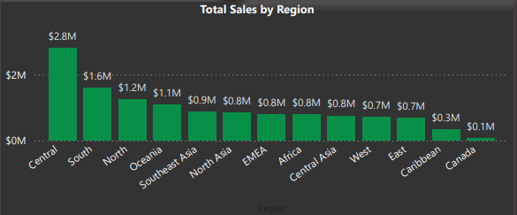
Store Overview In Sales

Slide 5
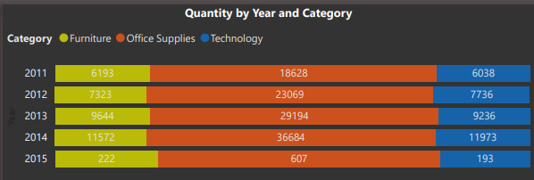
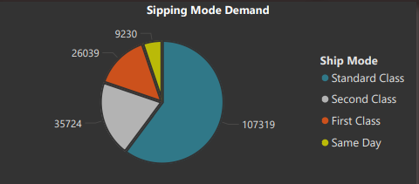
Quantity Sold Overview

Slide 6
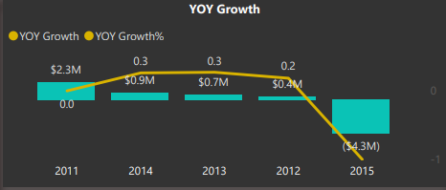
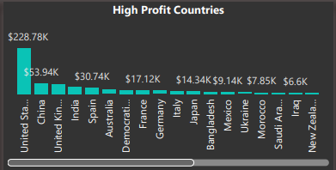
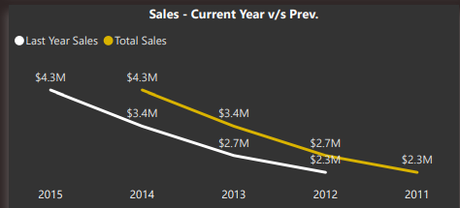
Yearly Review

Slide 7

Thank you

